Slide 1
Play2Learn
Cryptics
Group 11

Slide 2
The Concept
A game to help students to learn their lessons through fun.

Slide 3
The Features
For Teachers➔
Teacher’s Login via http://www.teachers.gov.bd
Set & Update categorized test questions
For Students➔
Play game by selecting desired subject/category
Select no. of questions to play
Game Scoring
Monthly progress graph

Slide 4
Concept Details
It will be a quiz game. Teachers will create question bank through the mobile app. Students will be able to play game by answering selected categorized questions set by teachers.
It will be very interactive learning process as this kind of games are interesting to the students. Scores will be valuable, so there will be competition among them. Thus they will LEARN THROUGH FUN.

Slide 5
What we developed in GDG
Wireframe

Slide 6
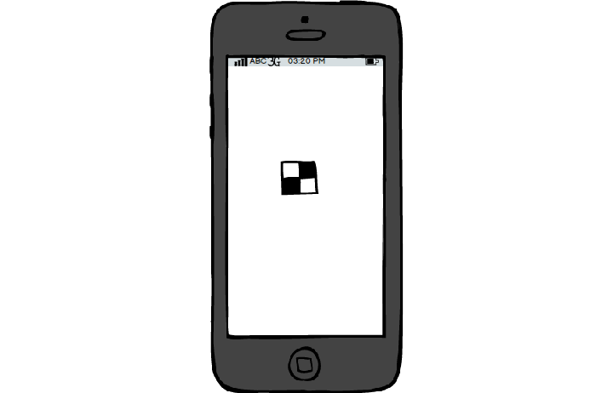
What we developed in GDG
Play2Learn

Slide 7
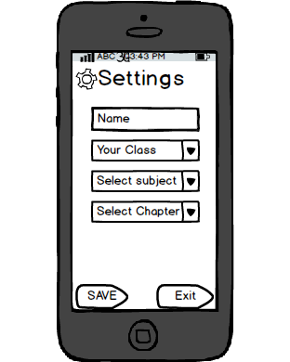
What we developed in GDG

Slide 8
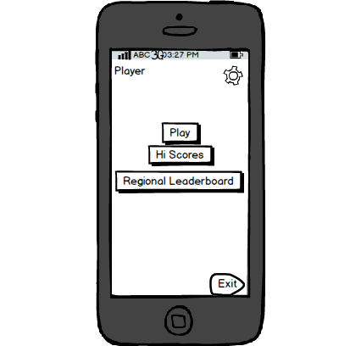
What we developed in GDG

Slide 9
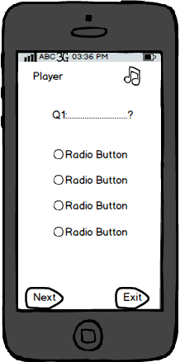
What we developed in GDG

Slide 10
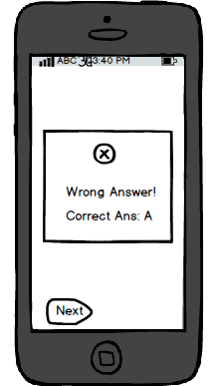
What we developed in GDG

Slide 11
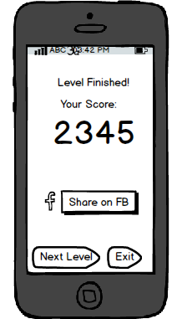
What we developed in GDG

Slide 12
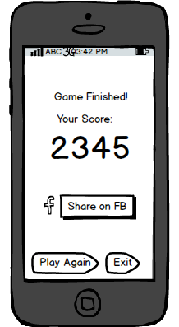
What we developed in GDG

Slide 13
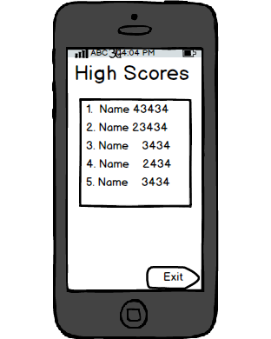
What we developed in GDG

Slide 14
Final Vision
Synchronization with central server
Regional Leaderboard
Sharing on the social networks

Slide 15
Supports We Need
Database on “//www.teachers.gov.bd
Google Maps API

Slide 16
Cryptics
Moinul Islam Sayed – 01924264608
Mohammad Zahid Hasan – 01912773042
GitHub: github.com/sayed11

